Slide 1
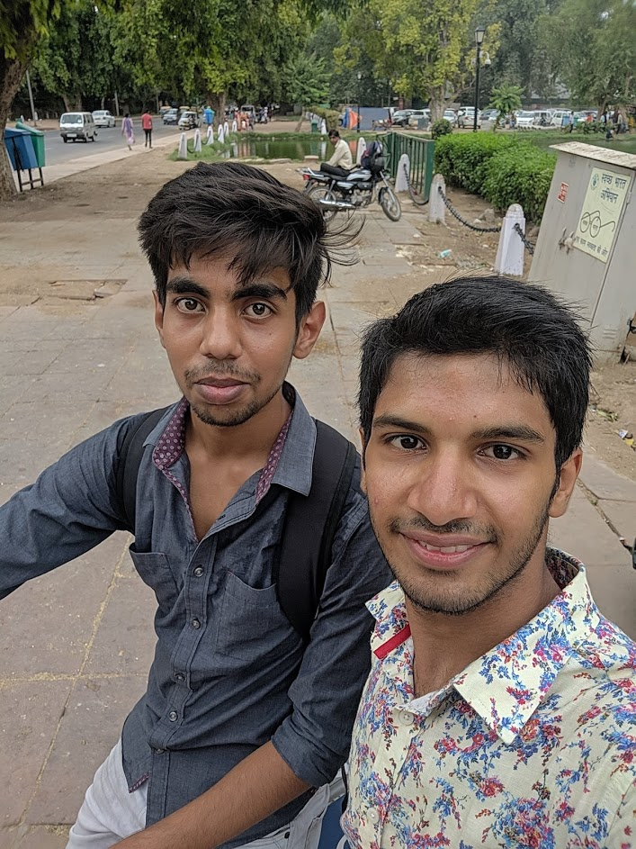
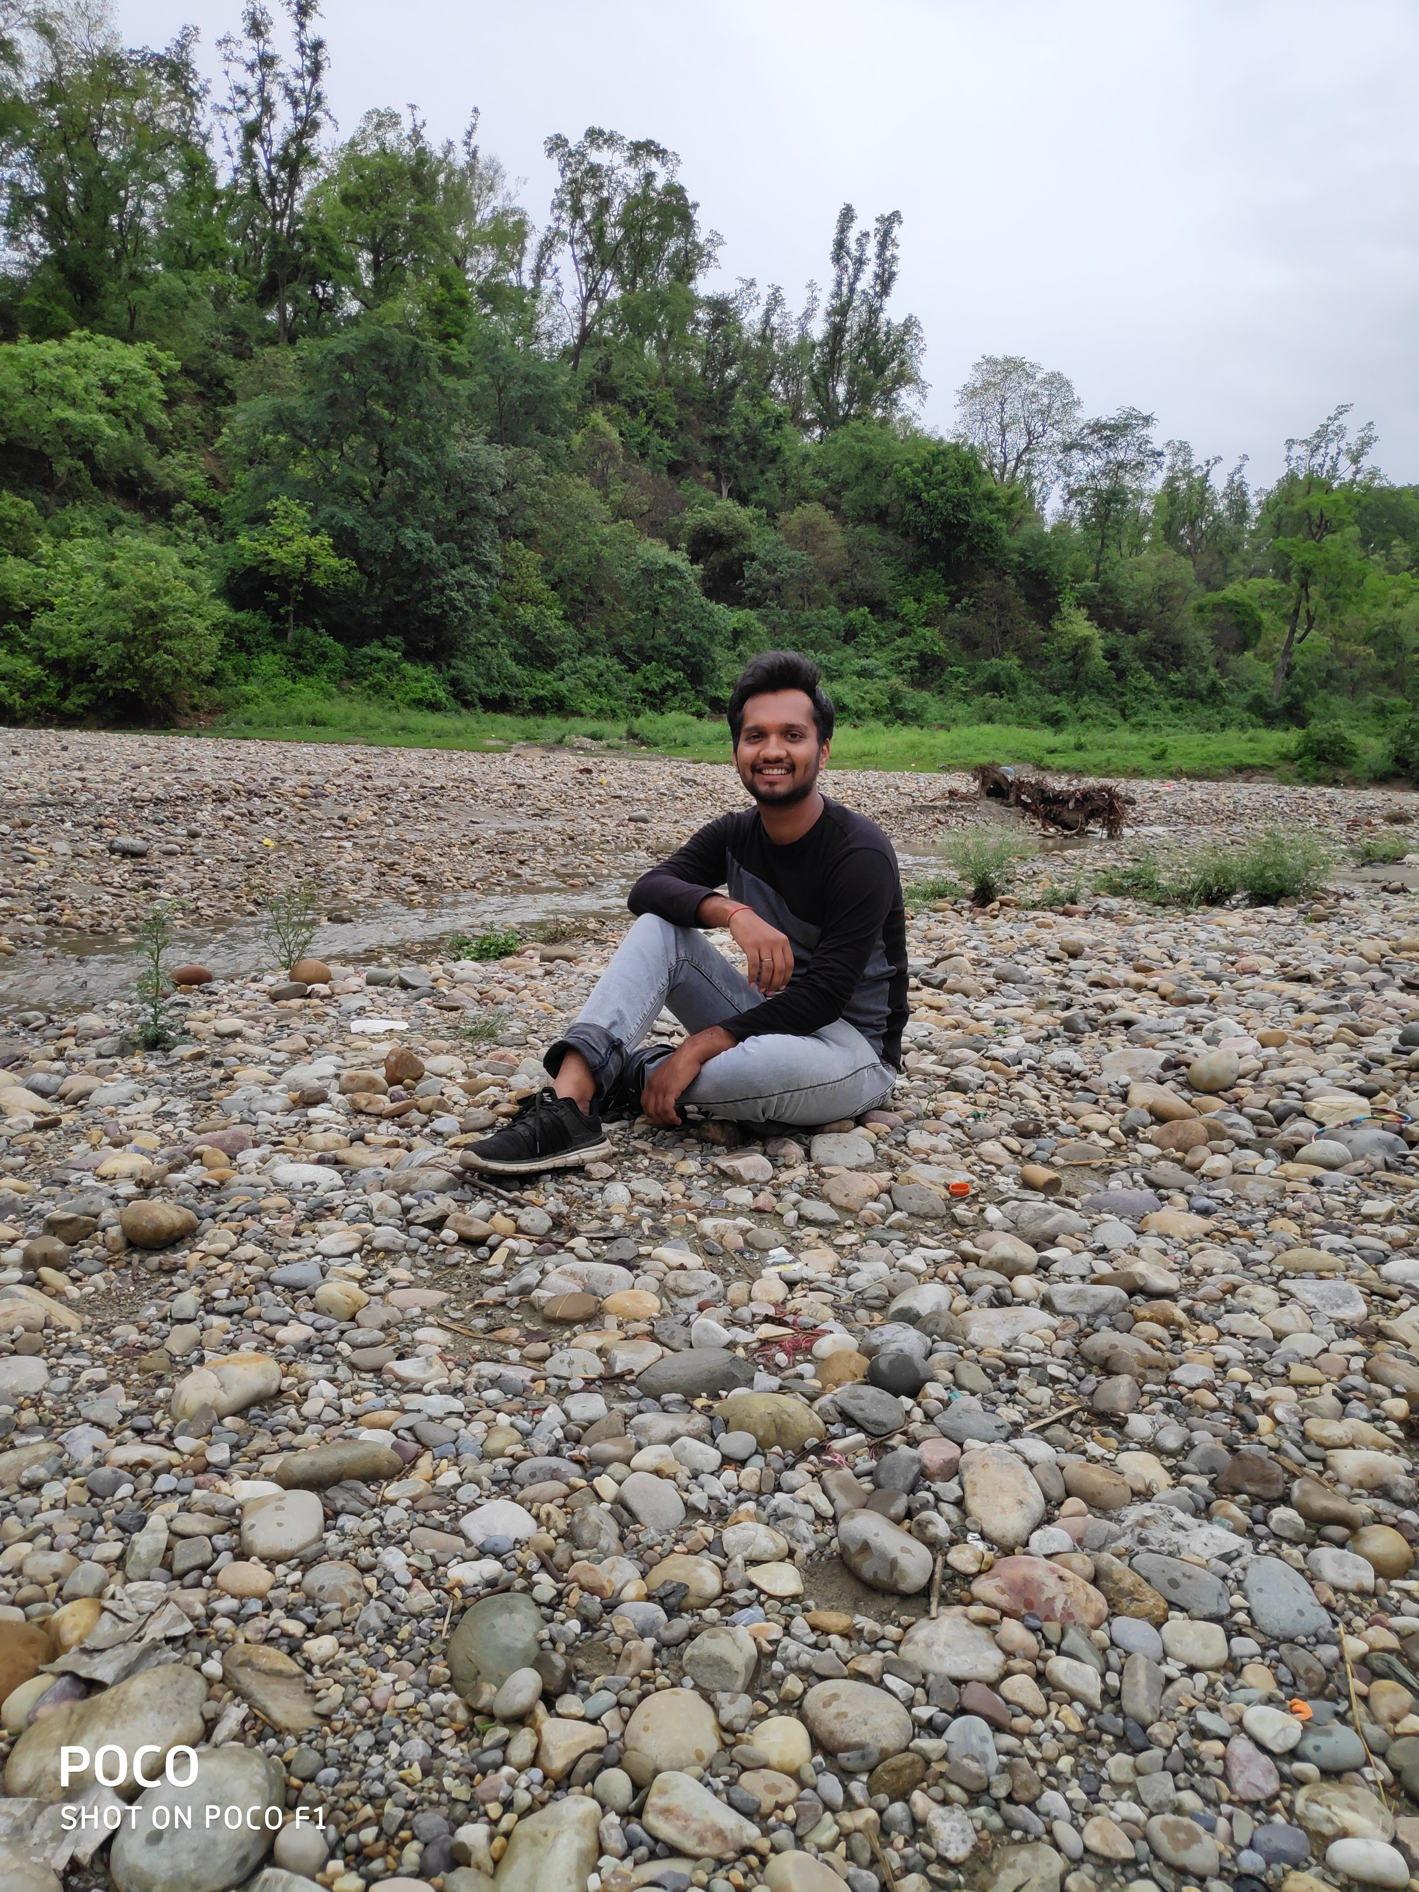
FRIEND AFFINITY FINDER
TEAM
Natural Noobs
Member#1
Siddharth Gautam
Member#2
Shriyans Kaushik

Slide 2
ROLES IN PROJECT AND EXPERTISE AREAS
Siddharth Gautam
Praw
IBM Watson
Research
Data Plotting
Structure
Shriyans Kaushik
Tweepy
StackAPI
Tkinter
Implementation
Working

Slide 3
Platform Used
Python
API’s Used
Tweepy, by Twitter
PersonalityInsight, by IBM Watson
SpeechToText, by IBM Watson
PRAW, by Reddit
StackAPI, by Stack Overflow

Slide 4
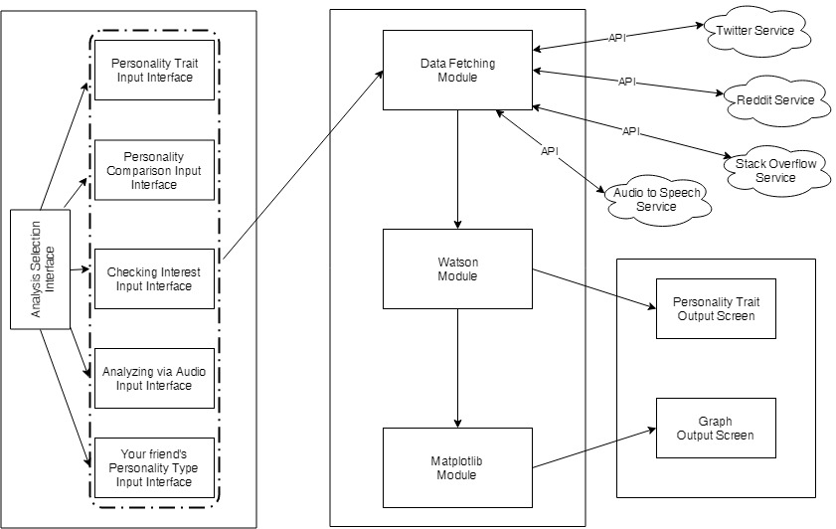
Architecture Diagram

Slide 5
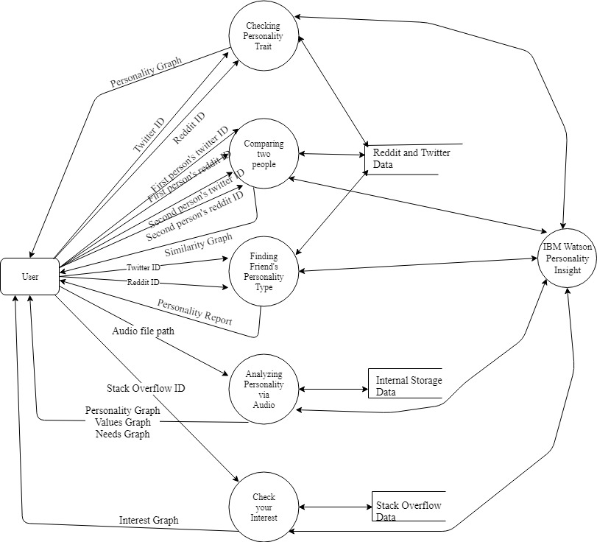
Data Flow Diagram
IBM Watson speech to text

Slide 6
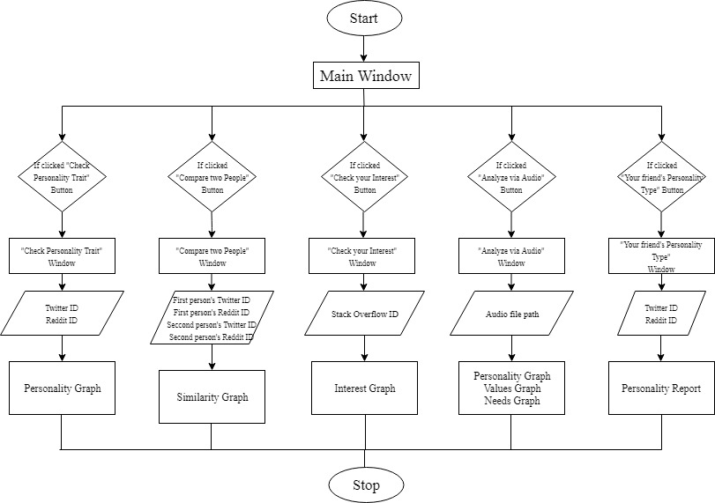
Flow Diagram

Slide 7
Framework/tools used
Tkinter is an in-built Python library which has been used for developing Graphical User Interface.
Tkinter is Python's de-facto standard GUI (Graphical User Interface) package. It is a thin object-oriented layer on top of Tcl/Tk.
It is a standard Python interface to the Tk GUI toolkit shipped with Python.
Python with tkinter outputs the fastest and easiest way to create the GUI applications.

Slide 8
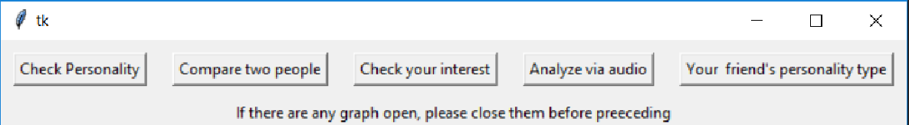
Main Window
Buttons:- They are used to initiate an action when clicked.
It is initiated in Tkinter by 'button=Button(frame)'
Label :- Labels are used to display static text which can’t be change during runtime.
It is initiated in Tkinter by “label=Label(frame)”

Slide 9
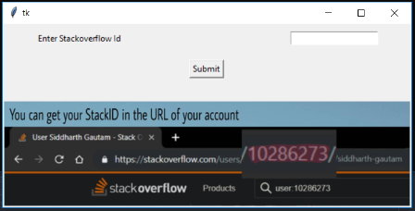
Checking Interest Window
Text field :-Text fields are used to display input data from the user during runtime.
It is initiated in Tkinter by “enter=Entry(frame)”
Image:- Images are used to give any information using a picture to the user.
It is initiated in Tkinter by “img=Image.open(path)”

